Slide 1
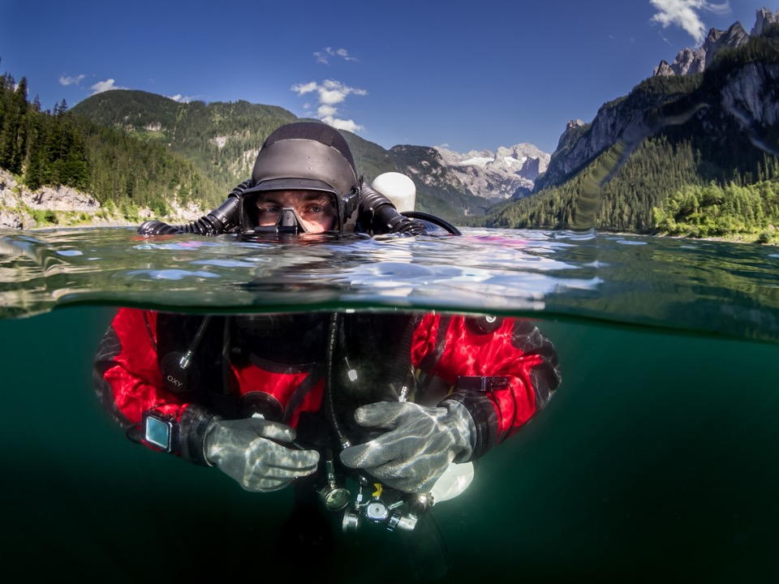

Ownership
Module CCRLT9
Liberty CCR Training

Slide 2
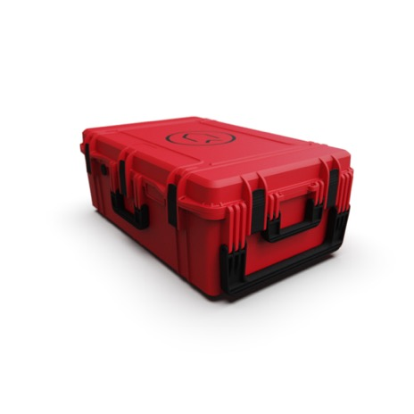
Lesson outline
  CE marking
  Warranty and insurance
  Hygiene
  Environmental considerations
  Transportation
  Maintenance and servicing
  Options and upgrades

Slide 3


UKCA/CE Marking
Implication of CE Marking:
  Comply with EN 14143
    UK BS EN 14143:2013 standard
    Defines
      The minimum operational characteristics
      Required servicing & use information
  Transition from CE to UKCA mark was in Jan 2022
Warning:
  Divesoft is responsible for the liability of a sold unit as the manufacturer
  At all times Goods sold should match the manufacturer’s specification
‘Add-on’ considerations
  Only options approved by Divesoft should be added to the Divesoft Liberty CCR

Slide 4
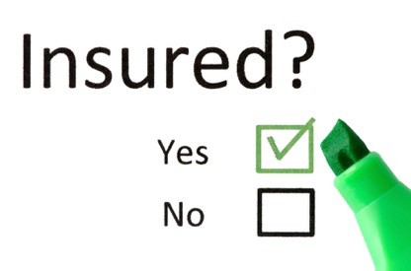
Warranty and insurance
Manufacturer’s Warranty:
  12 months
  Statutory rights & Common Law
Insurance:
  BSAC membership Third Party Liability Cover
    Within BSAC Safe Diving and recommendations
  Consider additional personal insurance to cover:
    Loss and damage
    Emergency jettison

Slide 5
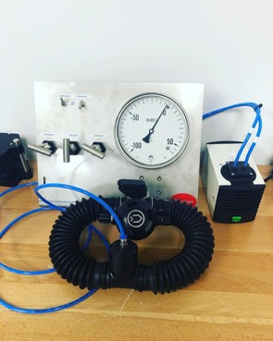
Need for hygiene
Breathing loop components:
  Mouthpiece & hoses
  All internal surfaces of head
  Counter-lungs
  Scrubber unit body, canister
  Scrubber water trap
Minimum at the end of dive day:
  Flush fresh water , drain & air dry
    Mouthpiece, hoses & counterlungs
    Scrubber unit?
At end of diving trip / approx. every 6 hrs. diving:
  Disinfect all loop components
  Rinse thoroughly to prevent deterioration
  Air dry

Slide 6
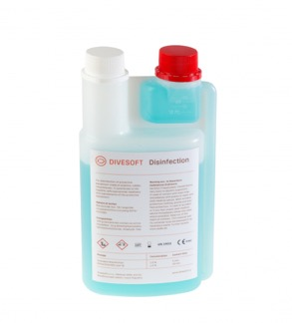
Disinfectant
Types of disinfectant:
  “Divesoft supplied disinfectant ”
    Manufacturer’s recommended disinfectant
    Product Warranty
    Harmful to aquatic life
  Bactericide such as
    Trigene, liquid Savlon, Dettox, Listerine, …
  No chlorine-based disinfectant (e.g. Milton)
  Dilution
  Do not use ozone generators
Potential allergic reactions

Slide 7
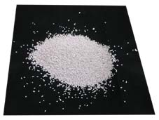
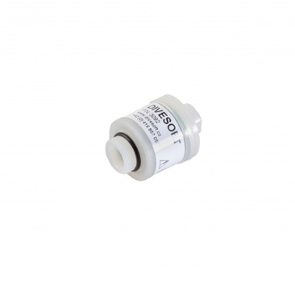
Environmental considerations
Respect the environment
Disposal of used absorbent material:
  Use locally approved waste disposal facilities
  Do not dump into the ocean
Galvanic sensors:
  Contain toxic chemicals
  Use local chemical waste disposal facility

Slide 8
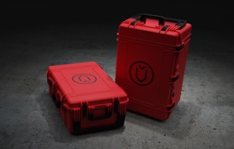
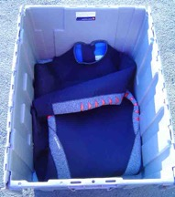
Transport by vehicle
Best in box
For long distances:
  Liberty fully assembled in correct size case
  Scrubber canister empty
    To avoid Danger of Sofnolime settling
  Protect vulnerable items by wrapping in soft packaging
    Handsets
    Gauges
    Loop separate to avoid crushing
  Use soft kit for general padding
  Set up Liberty at destination and run full tests

Slide 9
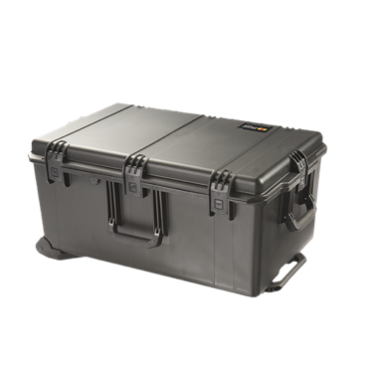
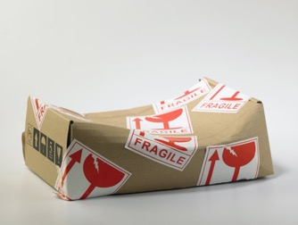
Transport - flying
Best in large suitcase, as when in suitcase it is less obvious as to contents, take head as hand luggage
Label outside & inside of box with:
  Name
  Destination address
“Fragile” stickers a good idea
Secure box with TSA compatible padlocks:
  Anticipate need to open boxes for inspection
  Soft packing
  Bubble wrap or soft kit
  Baggage handler’s finesse!!

Slide 10
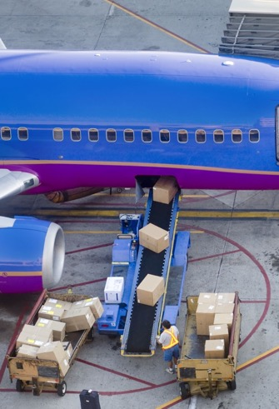
Transport - flying
Weight of basic unit in box:
Complete Liberty exceeds single item limit
Check with airline:
Extra weight allowance
Cylinders empty, valves open, ideally loose, best to hire at destination
Take Head as hand luggage less chance of damage
Documentation:
The Liberty passport
Absorbent material manufacturer’s transport datasheet

Slide 11
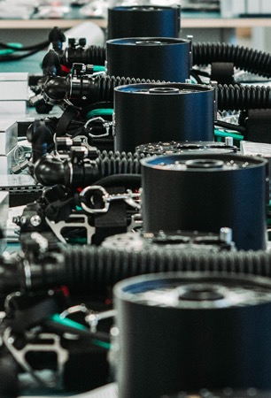
Servicing and maintenance
Routine maintenance:
  Done by owner
  At end of each diving day / trip
Periodic Maintenance / inspection:
  Done by owner
  Changing of oxygen cells
  Applying free firmware updates
    Using Divesoft Divecenter or the Divesoft Application
  Replacing damaged ‘o’rings ..etc
Regular servicing:
  Done only by approved Divesoft technicians
  Different levels of service dependent on Interval @ one year, three years and a five year service

Slide 12
Servicing and maintenance
Liberty Technician service operations
Service inspection – 1 year
  Visual inspection of all parts, electronics and sensors and eventual elimination of defects
  Cleaning of breathing circuit, canister, scrubber and the inside of the head
  Check of cylinders
  Leak test of head, canister, breathing circuit, all valves, inflator and eventual elimination of defects
  Full service of the regulators first stages
  Inspection of all valves (MAV, ADV, OPV, cylinder valves) and eventual elimination of defects
  Replacement of the most exposed O-rings and rubber parts
  Adding or replacement of damaged rubber rings on the harness

Slide 13
Servicing and maintenance
Liberty Technician service operations continued:
  Final functional test
  Final leak test
  Oxygen sensors will be replaced and firmware will be updated to the latest version after consultation with an owner of an unit. The replacement of the Oxygen sensors is not included in the service costs.
  Service inspection – 3 years
  There are performed all operations associated with the one year service inspection +
    Replacement of both battery packs
    Replacement of less exposed O-rings
  Service inspection – 5 years
  Perform all operations associated with the one year service inspection +
    Replacement of all hoses regardless of their condition

Slide 14
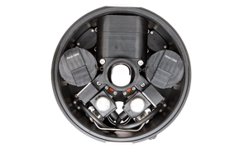
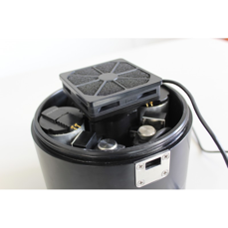
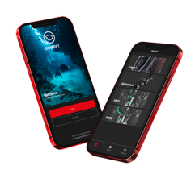
Routine user maintenance
After a day’s diving:
  Flush handsets, head, mouthpiece, hoses and counterlungs with fresh water
  Remove head from scrubber
    Use tissue to soak up excess moisture
    Thoroughly airdry the head & all internal components use the drying fan if needed to dry off the oxygen cells
    Log days diving details (Ideally download with App or PC)
    Confirm battery life remaining
  Visual inspection
    External
      all Hoses, Wing, Loop connections, Handsets, Counter lungs
  Check remaining absorbent life

Slide 15
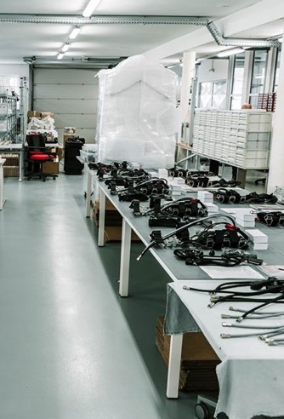
Routine maintenance
After each diving trip:
  Wash whole unit in fresh water
  While soaking with fresh water operate:
    All Manual inflators
    BOV, or DSV
    ‘Wing’ inflator & deflator
  Disinfect, rinse and dry the loop:
    Mouthpiece
    Hoses
    Counter-lungs
    Head & Scrubber body
  Air dry all components
  Fully recharge the batteries
  Do NOT seal head until completely dry

Slide 16

Routine maintenance

Slide 17
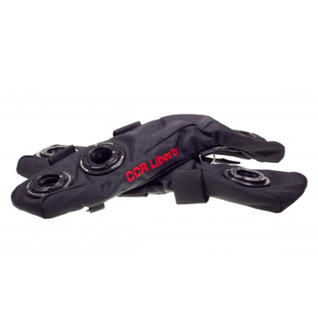
Periodic maintenance
Counterlungs:
  Inspect / test bladders regularly for debris and damage
Mouthpiece/BOV:
  Easy operation - lubricate if required must only use Krytox GPL 201
Oxygen sensors:
  Replace, if necessary, but replace at 12 months from date of first use, or 18 months of date of manufacture

Slide 18
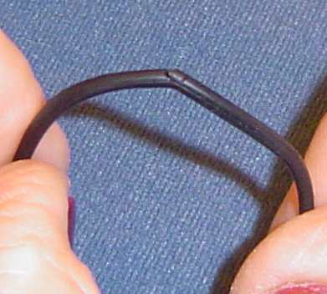
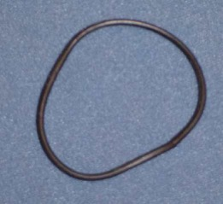
Periodic maintenance
“O” rings:
  Inspect for
    Abrasions
    Nicks or cuts
    Stretching / slack fit
    Replace!
Lubrication:
  Oxygen compatible grease on all items exposed to high PO₂
    Krytox GPL 205
    Krytox GPL 226
    Rocol Fomblin
    Cristolube
  Silicon grease for non-O₂ parts

Slide 19
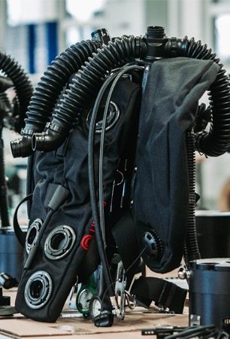
Servicing
Respect manufacturer’s service schedule
Annual winter service?
To be done by Divesoft approved technicians:
  For rebreather components
  For electronics
IDEST for:
  Cylinder inspection & test
  Oxygen clean cylinder if required
  Divesoft or Apeks approved technicians for Regulators
  (Ensure if only Apex approved technicians they know about special Divesoft supplied regulator O ring )

Slide 20
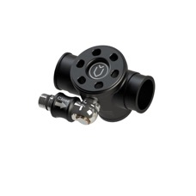
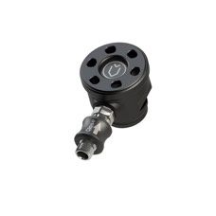
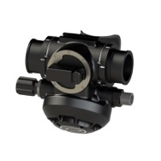
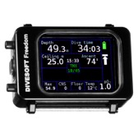
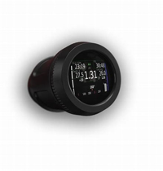
Options and upgrades
Automatic Diluent Valve (ADV)
  Options for different types and placement
Bailout mouthpiece:
  Bailout vastly simplified
  MUST carry independent bailout system for team members
  Backup decompression computer?
  Not a major requirement as you have completely redundant computers integrated in the Liberty
  Computer Unit (CU) upgrades
  Upgrade of pre 2021 CUs to 2021 or later CUs
  ODA = Optical Display Adaptor
  Only available with post 2021 CUs

Slide 21
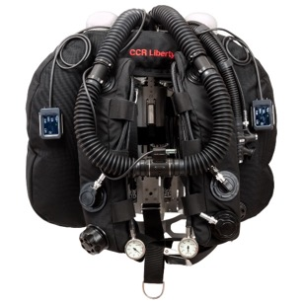
Summary
Look after your Liberty
CE marking
Warranty and insurance
Hygiene
Environmental considerations
Transportation
Maintenance & servicing
Options and upgrades
Your life depends on it!

Slide 22

Any questions?
bsac.com
facebook/britishsubaquaclub | twitter.com/bsacdivers
(0)151 350 6200 | info@bsac.com

